Slide 1
Fitness Tracker
Monitor Your Progress, Achieve Your Goals
(Rabia Naseer:302655)

Slide 2
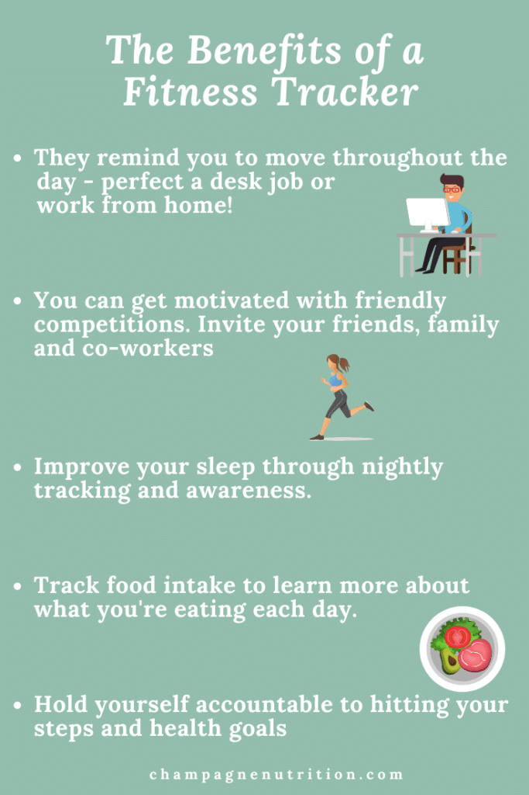
Benefits Of Fitness Tracker
Monitor progress and stay motivated
Set and achievement fitness goals
Improve overall health and wellness
Enhance person performance
Image: A person excising or a fitness tracker device

Slide 3
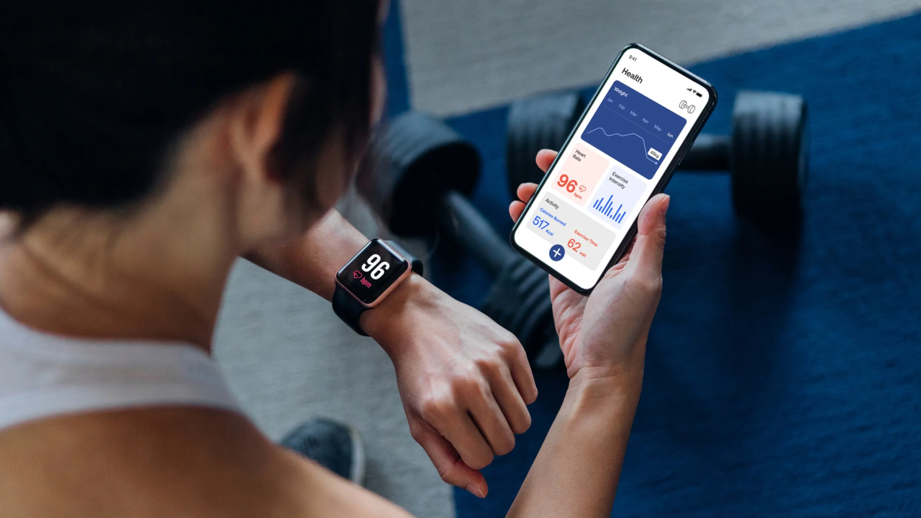
How to Use Our Fitness Tracker
Wear the fitness tracker device
Download and install the app
Set up your profile and goals
Track your progress and receive insights
Image: an illustration of a person using the fitness tracker

Slide 4
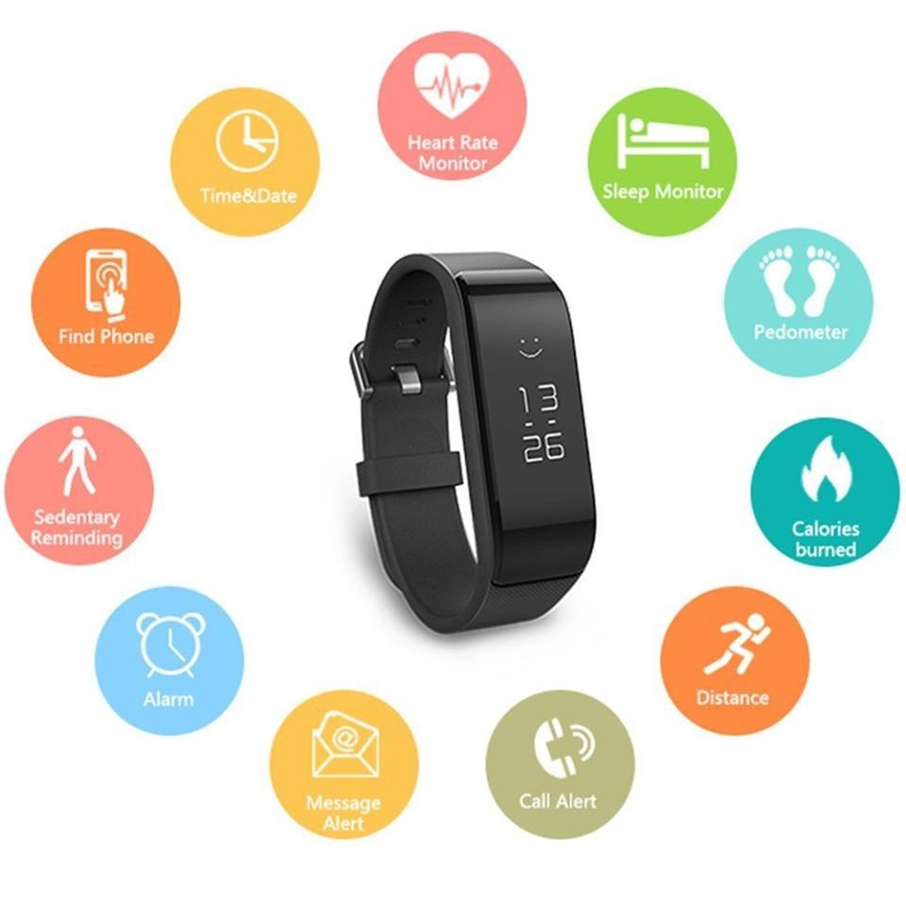
Features Of Our Fitness Tracker
Step Tracking
Distance Tracker
Calories burn Tracker
Heart rate monitoring
Image: A screenshot of the fitness tracker app or device

Slide 5
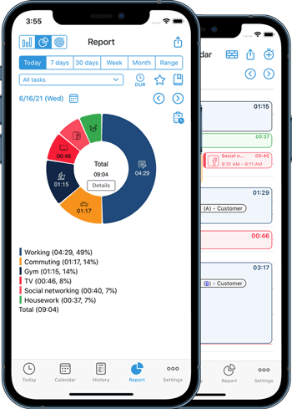
Goals And Progress Tracking
Goals setting (e.g. run 10km in 2 Weeks)
Progress tracking (e.g,step taken,distance covered)
Image: a graph or chart showing progress over time

Slide 6
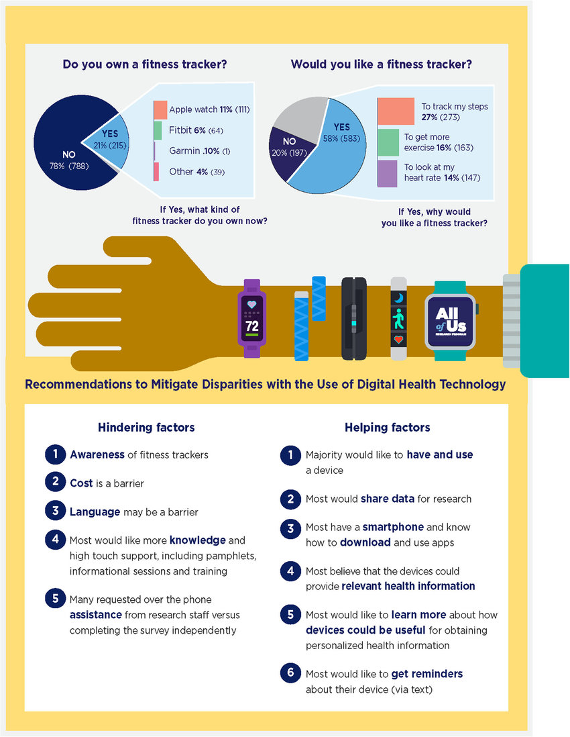
Insights And Recommendation
Insight(e.g. most active hours, sleep patterns)
Recommendation (e.g. workout routine, nutrition's plans)
Image: a person receiving insights and recommendation of their device

Slide 7
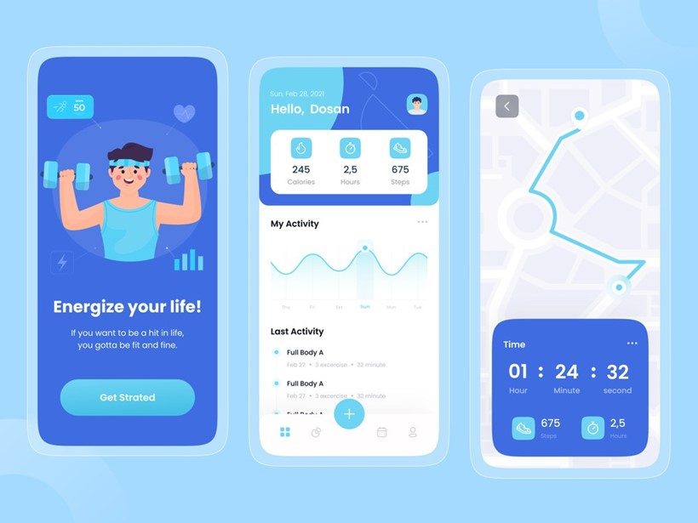
Conclusion:
Summary of key points
Call–to-action (e.g. download the app purchase the device)

